Slide 1

Online Banking Simulation…
Name: Md Faizan & Sara Mohammad Jamil
Admission No: 23SCSE1012768 & 23SCSE1012440

Slide 2
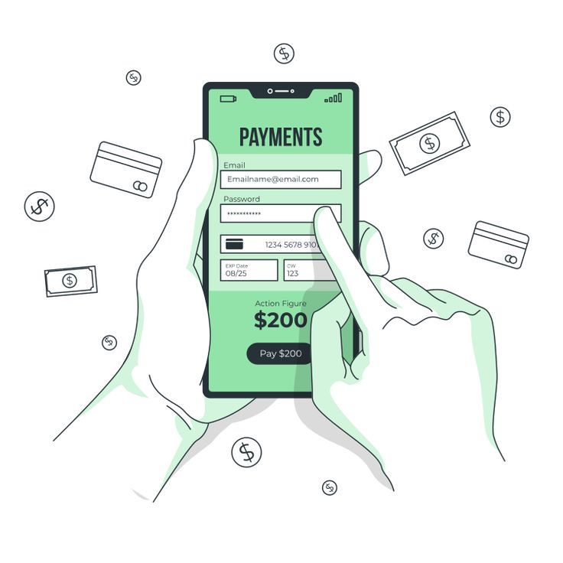
Introduction of Online Banking Simulation
Convenience: Online banking offer accessibility to financial services from the comfort your home, anytime, anywhere.
Efficiency: Save time and effort by completing banking tasks quickly and easily, without visiting a branch.
Security: Modern online banking platforms employ advanced security measures to protect your financial data and transactions.

Slide 3
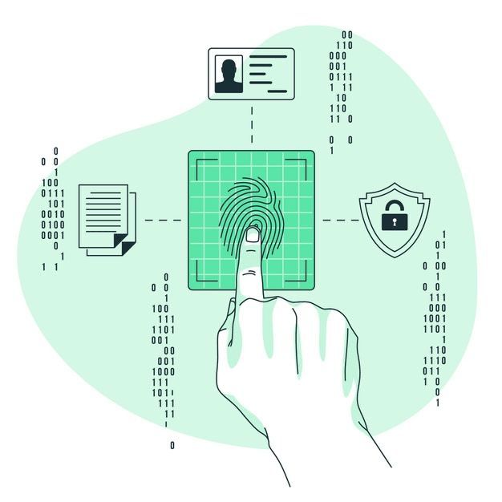
Abstract for Online Banking
Project Overview: This is a Java-based online banking simulation that mimics real banking functions.
Purpose: To help users learn how to manage bank accounts online safely and easily.
Technology Used: Built with Java, utilizing its object-oriented programming for efficient coding.
User Interface: Simple and friendly design for easy navigation.
Educational Tool: Aimed at helping users understand online banking and gain confidence in using digital banking services.

Slide 4

Abstract for Online Banking
Key features provide in Online Banking.
Account Creation: Users can set up their virtual bank accounts.
Secure Login: Safe access to personal accounts.
Balance Check: Users can view their current account balance.
Transaction History: A record of past transactions is available.
Fund Transfers: Easy transfer of money between accounts.

Slide 5

Objective of Online Banking
User Interface: To develop a user-friendly and intuitive interface that simulates a real online banking experience.
Core Functionality: To implement core banking functionalities such as account creation,deposits, withdrawals, and balance inquiries.Data Security to prioritize data security by implementing measures to protect sensitive user information and transactions.
Data Security: To prioritize data security by implementing measures to protect sensitive user information and transactions.

Slide 6



Modules of Online Banking
Account Management
Allows users to view account balances, transaction histories, and manage their personal information.
Funds Transfer
Enables users to securely transfer funds between their own accounts or to external recipients.
Bill Payment
Offers a convenient way for users to pay their bills and utilities directly from the online banking platforms.

Slide 7
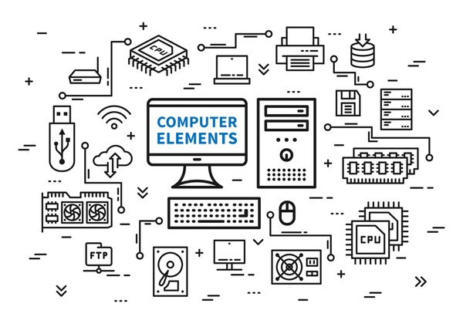
Software and Hardware Requirements
Web Server: A reliable and scalable web server to host the online
banking application.
Database: A secure and efficient database system to store user
data and financial information.
Encryption: Strong encryption algorithms to protect sensitive data
during transmission and storage.
Client Devices: A variety of devices, such as smartphones, tablets, and computers, for users to access the online banking platform.

Slide 8
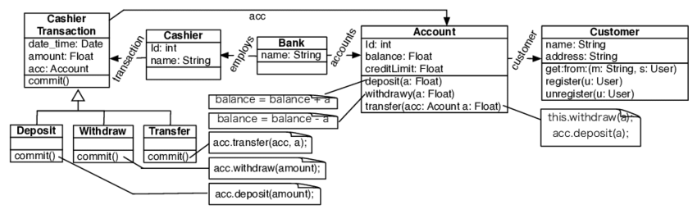
Architecture Diagram

Slide 9

Conclusion
Online banking makes managing money easy and convenient. It allows us to check balances, pay bills, and transfer money anytime, from anywhere. With a focus on security and user-friendly design, online banking saves time and reduces the need to visit physical banks. Overall, it empowers us to take control of our finances and simplifies our daily banking tasks.

Slide 10


